Slide 1
BGP - Part 1
CS 168 – Fall 2017 – Section 11

Slide 2
Administrivia
Project 3 due this Friday (11/17)

Slide 3
Agenda
Interdomain Routing (BGP)

Slide 4
BGP: Overview
Routing between ASes
AS = Autonomous System
A “domain”
Independently run network
AT&T, UC Berkeley, Comcast, Google, etc.
Companies, organizations, ISPs

Slide 5
Interdomain Routing
ASes are autonomous
They want to…
Choose their own internal routing protocol
How to send packets within their domain
Choose their own external policy
E.g.: I don’t want to carry traffic directly from Google…
Pick routes based on policies
Keep policies private

Slide 6
Three parts
eBGP
Between border routers in different ASes
Learn about external routes
iBGP
Between border routers and other routers within a single AS
Routers learn which border router to use for each external route
IGP
The protocol used for intradomain routing (e.g. OSPF).
Shortest path to subnet in the same AS
Shortest path to border router for given external network
Just a different name for L3 routing as we’ve talked about earlier

Slide 7
The Big Picture
How does this fit with what we’ve learned so far?

Slide 8

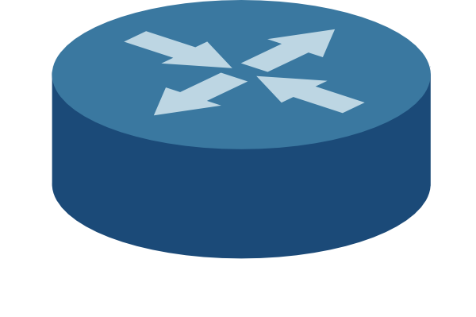
L2: LAN
Destinations are MAC addresses
Learning switches
Default gateway
3rd floor Soda
1.2.4/24
Host
IP: 1.2.3.6
MAC: …
Default gateway
Subnet (4th floor Soda)
1.2.3/24
Default gateway
7th floor Soda
1.2.5/24
Host (you)
IP: 1.2.3.4
MAC: 01:0a:00:00:0b:02
Host
IP: 1.2.3.5
MAC: …
LAN

Slide 9
Domain (AS)
UC Berkeley
IP prefix: 1.2/16
L3: Intradomain
Destinations are IP addresses
IGP: exchange info about paths to local destinations
DV routing and friends
3rd floor Soda
1.2.4/24
4th floor Soda
1.2.3/24
7th floor Soda
1.2.5/24
WAN: Intradomain

Slide 10
Domain (AS)
Border router
Border router
UC Berkeley
IP prefix: 1.2/16
Google
7.8/16
Border router
Border router
3rd floor Soda
1.2.4/24
MIT
5.6/16
Border router
4th floor Soda
1.2.3/24
7th floor Soda
1.2.5/24
AT&T
3.4/16
WAN: Interdomain

Slide 11

Domain (AS)
UC Berkeley
AS number: 1
IP prefix: 1.2/16
Google (4)
7.8/16
Interdomain: eBGP
Between border routers in different ASes
Learn about routes to external networks
Destinations are IP prefixes
3rd floor Soda
1.2.4/24
MIT (3)
5.6/16
5.6/16
Path: {3}
4th floor Soda
1.2.3/24
7th floor Soda
1.2.5/24
AT&T (2)
3.4/16
WAN: Interdomain

Slide 12
Domain (AS)
UC Berkeley
AS number: 1
IP prefix: 1.2/16
5.6/16
Path: {3,2}
Google (4)
7.8/16
Interdomain: eBGP
Between border routers in different ASes
Learn about routes to external networks
Destinations are IP prefixes
3rd floor Soda
1.2.4/24
MIT (3)
5.6/16
4th floor Soda
1.2.3/24
7th floor Soda
1.2.5/24
AT&T (2)
3.4/16
WAN: Interdomain

Slide 13

Domain (AS)
UC Berkeley
Intradomain: iBGP
Border routers and other routers within a single AS
To which border router should I send packets for MIT?
3rd floor Soda
1.2.4/24
4th floor Soda
1.2.3/24
7th floor Soda
1.2.5/24
iBGP

Slide 14
Soda 4th Floor → MIT
LAN
LAN
Default gateway
Default gateway
4th floor Soda
2nd floor CSAIL
Border router
Border router
UC Berkeley
ASes
MIT

Slide 15
In the end…
Host knows how to…
... get to the default gateway on its local subnet
Default gateway knows how to...
... get to the right border router
Border router knows how to...
... get to the right AS
AS knows how to...
... get to the right internal host

Slide 16
Today
The routing mechanics
We will not talk about specific policies…
For next section

Slide 17
Similarities between BGP & DV routing
Destination based
No global view of network
Iterative and distributed convergence

Slide 18
Differences between BGP & DV routing
May choose path that is not the shortest
Base choices on policy instead
Path vector
Don’t send distance, send path
Crucial for avoiding loops
Route aggregation
Combine network prefixes when possible
Selective route advertisement
Don’t have to send updates to all neighbors

Slide 19
Not Picking Shortest Route
AT&T
(1)
Facebook
(2)
Google
(3)
AT&T may pick path {1, 2, 3} over {1, 3}

Slide 20
Path Vector
AS 1 1.2/16
AS 2
AS 3
1.2/16
Path: {1}
1.2/16
Path: {2,1}

Slide 21
Path Vector Benefits
Loop avoidance
How?
Don’t use a path we’re already on
Allows for flexible policies
AS can avoid paths through certain other ASes, countries, etc.

Slide 22
Route Aggregation
dst: 1.4.5.6
dst: 1.3.4.5
Combine prefixes
→ Scalability
1.0.0.0/8
This way!
AT&T
1.0.0.0/8
UC Berkeley
1.2/16
Stanford
1.3/16
Google
1.4/16

Slide 23
Selective Route Advertisement
AS may advertise routes to only some neighbors
Based on policies
AT&T
Facebook
Google

Slide 24
Selective Route Advertisement
E.g. Facebook might not want to carry traffic between AT&T and Google
Don’t tell AT&T about path to Google
Don’t tell Google about path to AT&T
AT&T
Facebook
Google

Slide 25
Export & Selection
Export: Choose which routes to advertise
Determines where AS will receive traffic from
Which traffic to carry
Selection: Choose route advertisements to accept
Determines where AS will send traffic

Slide 26

Export & Selection
UCB and Facebook export their route to Stanford
They agree to carry AT&T’s traffic to Stanford
Stanford this way!
UC Berkeley
Google
AT&T
Stanford this way!
Facebook
Comcast

Slide 27
Export & Selection
AT&T selects route through UC Berkeley
AT&T might now send traffic to Stanford via UCB
UC Berkeley
Stanford this way!
Google
AT&T
Facebook
Comcast

Slide 28
Export & Selection
AT&T exports route to Google only
Agrees to carry Google’s traffic to Stanford, but not Comcast’s
UC Berkeley
Stanford this way!
Google
AT&T
Facebook
Comcast

Slide 29
Worksheet

